Slide 1
Security Review of Protocols
CSYS 4483-01/CSYS 6683-01 Network Defense
Tirthankar Ghosh, Ph. D.

Slide 2
Vulnerabilities with IP
IP spoofing: A source can send packets with fake IP address.
Authentication based on source address will not work.
Fake return address is included.

Slide 3
IP Address Spoofing
When spoofing is used with connectionless protocols (like UDP or ICMP), the activity is not easy to detect.
Fraggle attack: sending spoofed UDP packets to port 7 (echo). The attacker sets both source and destination ports to 7 on two hosts that the attacker is targeting.

Slide 4
IP Address Spoofing (cont’d)
Spoofed packets can also be used to cause amplification effect if they are sent to a broadcast address.
TCP packets are never sent to a broadcast address.
Smurf attack: An attacker spoofs an ICMP Echo Request packet with the source address indicating the intended victim, and the destination address as the subnet broadcast address.
Essentially, all border routers are configured to reject traffic directed to the subnet broadcast address.

Slide 5
IP Packet Fragmentation
All hosts must accept packets with a minimum length of 68 bytes (an internet header may be up to 60 bytes, and the minimum fragment is 8 bytes) (RFC 791).
Problems with fragmentation:
If duplicate fragments are received with differing contents, which fragment to save?
For overlapping contents in fragments, which one will take precedence?
An attacker creates a packet with Fragment Offset of 65,528, and 1480 bytes of data, thus making the total packet length of 67,008 (maximum packet length can be 65,535). Possible that other data in the OS can be overwritten, causing the system to crash.

Slide 6
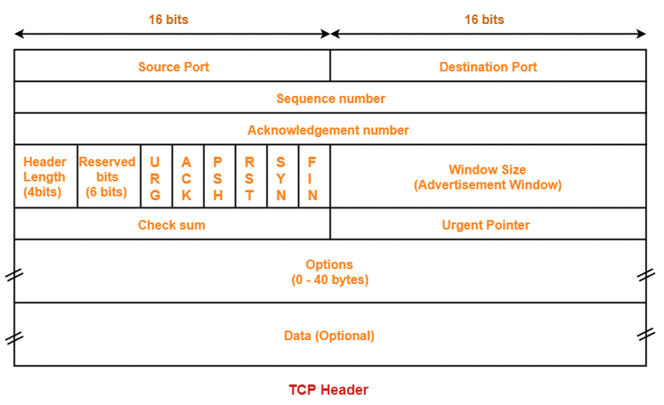
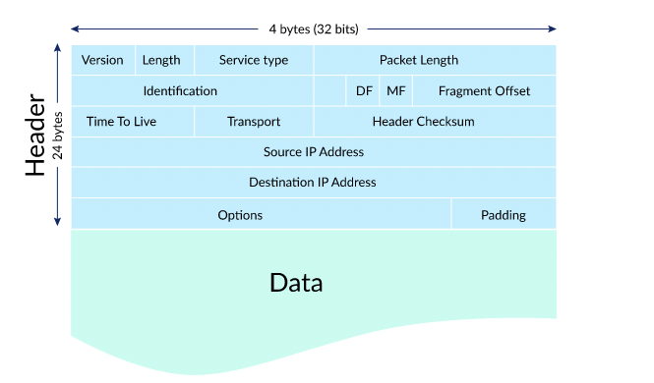
Vulnerabilities with IP (cont’d..)
IP fragmentation attack – Read RFC 1858.
Tiny fragment attack
Overlapping fragment

Slide 7
ARP Abuses
ARP Flooding
MAC Spoofing
ARP Spoofing

Slide 8
ARP Flooding
In a switched network, a switch maintains a cache of ARP responses to route traffic to a host.
When the cache is full, a switch either:
Reverts back to the hub mode
Flushes its buffer
In both cases, traffic destined to a specific port will “leak”, which is of potential interest to hackers.
Hackers can create a flood of spoofed ARP reply packets overflowing a switch’s ARP cache, and forcing it to the hub mode.

Slide 9
MAC Spoofing
Practically every Ethernet adapter can be reprogrammed to have any desired hardware address.
Hackers can reprogram the Ethernet adapter on a system to spoof that of another system on the network.

Slide 10
ARP Spoofing
ARP response packets can be spoofed to divert and disrupt traffic.
Hackers can combine ARP spoofing with Denial of Service (DoS) attack on specific target host preventing it from responding.
Can be used for Person-in-the-Middle attack (most times referred to as Man-in-the-Middle or MITM)

Slide 11
Vulnerabilities with TCP and UDP
Exploiting half-open TCP connection.
TCP Sequence number attack:
Guessing initial sequence number to fool the target host.
UDP spoofing: It is easier to spoof UDP packets because of no handshaking.
Each system using UDP has to have its own authentication mechanism.

Slide 12
TCP SYN Flood Attack
Exploiting half-open connection state.
Remedial measures:
Limiting connection rate
Purging stale connections
Using SYN cookies
Initial sequence number is cryptographically generated from IP address and port number.
No need to keep pending connections in queue.
Biggest drawback is that cryptographic operation demands increased CPU utilization.
Video tutorial

Slide 13
TCP Control Packets with Data
RFC 793 does not prevent transport of data in a SYN, FIN or RST packet.
Normally, TCP/IP stacks will not send data in these packets.

Slide 14
Vulnerabilities with ICMP
Used to inform hosts of a better route to the destination, to report trouble with a route, or to terminate a connection because of network problem.
Hackers can use ICMP to tear down connections, or creating new paths to destinations.

Slide 15
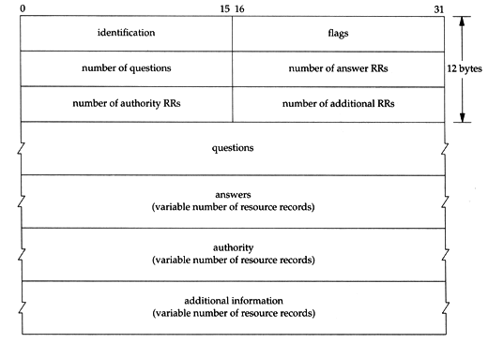
DNS
DNS uses two logically separate trees, the first maps host names to IP addresses, the second maps IP addresses to names.
DNS Query and Response
Ref.: https://flylib.com/books/en/3.223.1.151/1/

Slide 16
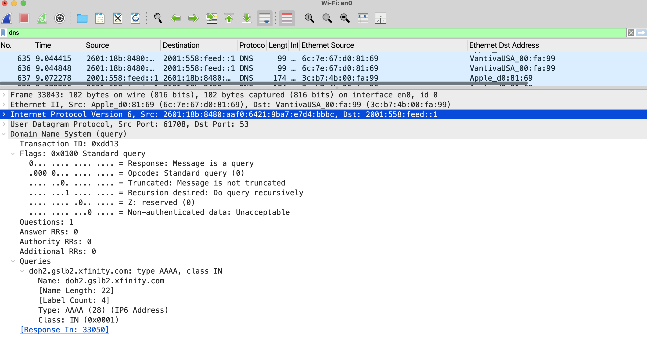
DNS Query

Slide 17
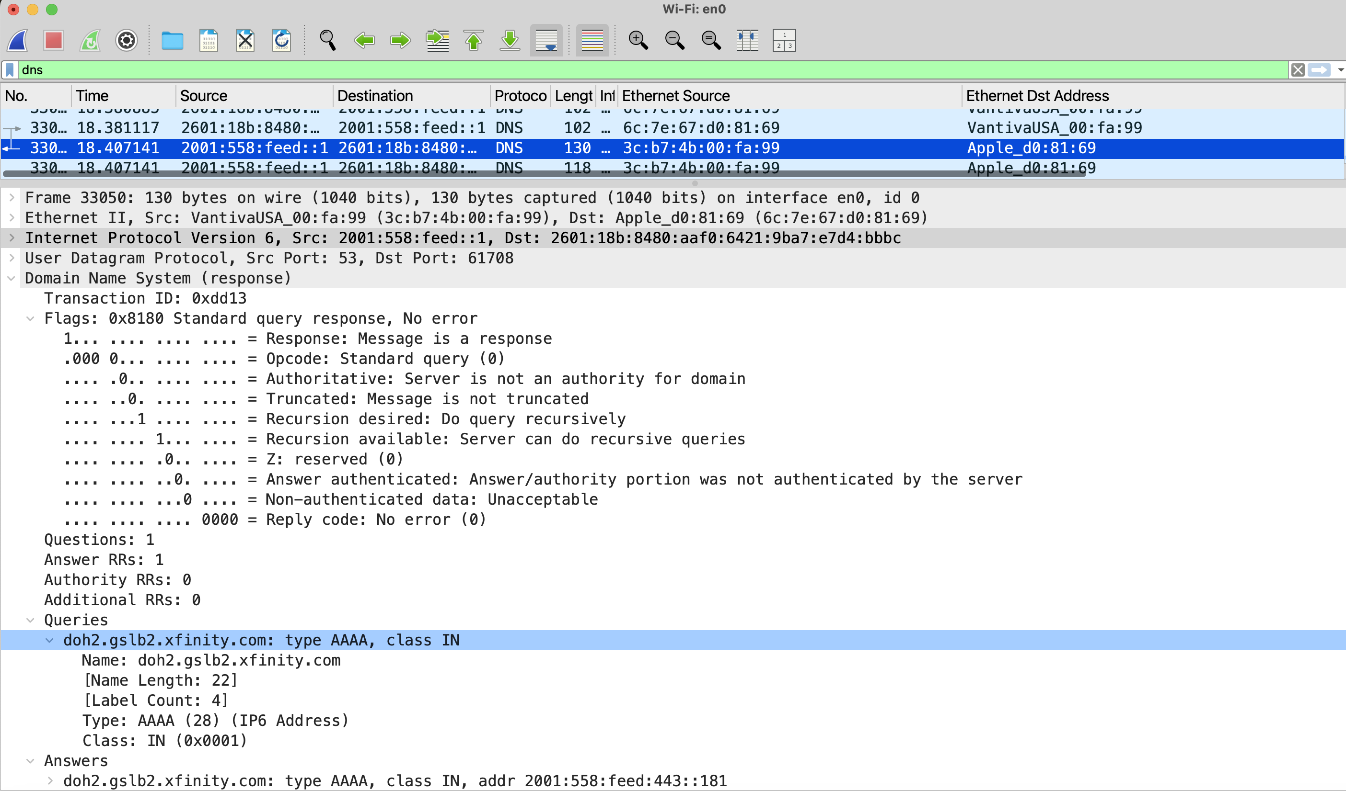
DNS Response

Slide 18
Vulnerabilities with DNS
DNS Cache poisoning attack
Bailiwick checking
Mitigation
DNSSEC – how DNSSEC works

